Slide 1
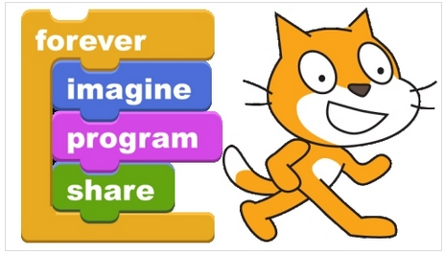
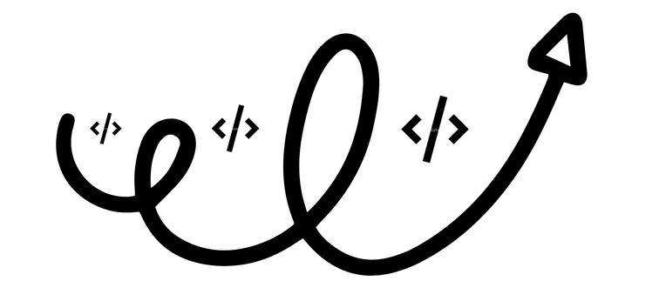
Loopy Loop
Week 3
Sumaiyah Zahid

Slide 2
Loop World
Start
Eat
Sleep
Code
Go to Line 2
End
The real power of computers is in their ability to repeat
an operation or a series of operations many times.
When action is repeated many times, the flow is called a
loop.

Slide 3
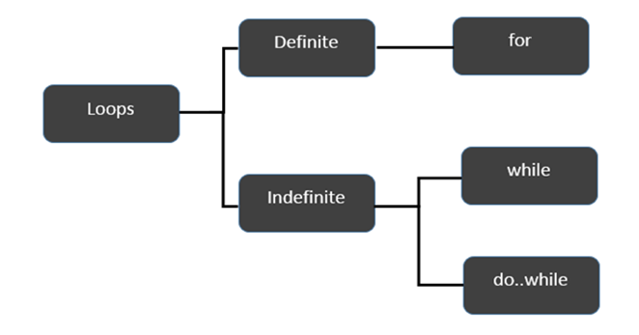
Loop Logic Structure

Slide 4
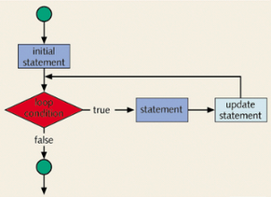
FOR Loop
for(initial statement; loop condition; update statement)

Slide 5
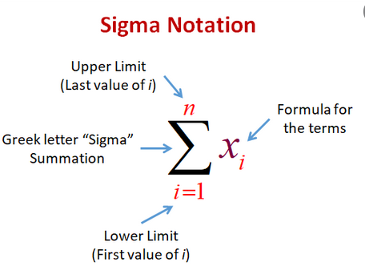
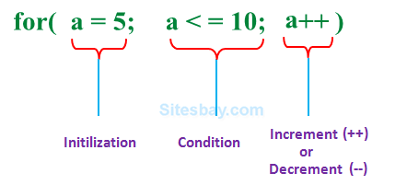
FOR LOOP

Slide 6
For Loop Execution
The for loop executes as follows:
The initial statement executes.
The loop condition is evaluated. If the loop condition evaluates to true
Execute the for loop statement.
Execute the update statement.
Repeat Step 2 until the loop condition evaluates to false.
The initial statement usually initializes a variable is the first statement to be executed and is executed only once.

Slide 7
#include <stdio.h>
int main()
{
int i;
for (i=0; i<5; i++)
{
printf("Hello World\n");
}
return 0;
}
}

Slide 8
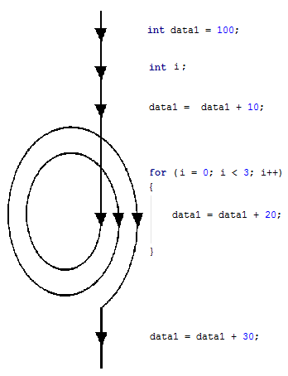

Slide 9
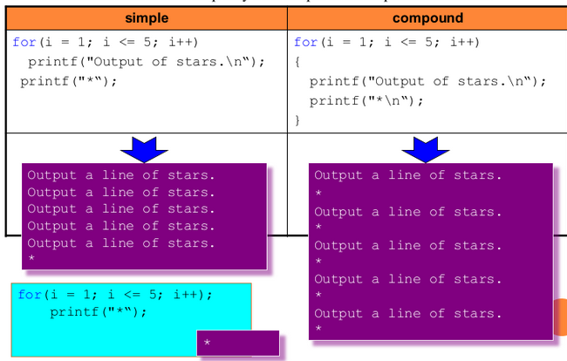

Slide 10
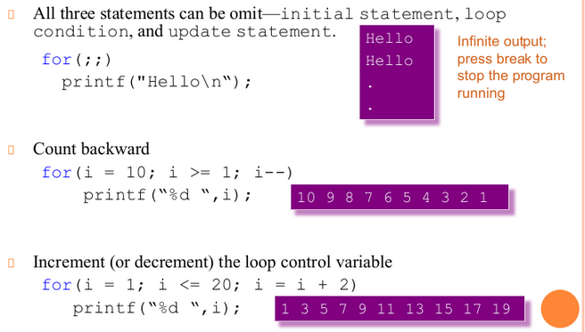

Slide 11
Suppose we want to add five numbers (say to find their average).
From what you have learned so far, you could proceed as follows.
scanf(%d %d %d %d %d,&num1,&num2,&num3,&num4,&num5);
sum = num1+num2+num3+num4+num5;
average = sum/5;
Suppose we wanted to add and average 100, or 1000, or more numbers. We would have to declare that many variables, and list them again in scanf statement, and perhaps, again in the output statement.

Slide 12
#include <stdio.h>
int main()
{
int sum=0,i, new_num,avg;
for (i=0; i<5; i++)
{
printf("Enter Number ");
scanf("%d",&new_num);
sum=sum+new_num;
}
avg=sum/5;
printf("The Sum is %d \n",sum);
printf("The Average is %d \n", avg);
return 0;
}

Slide 13
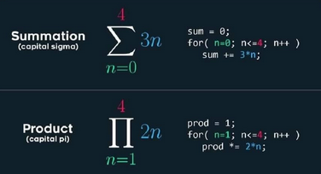

Slide 14
Home Exercise
Using for loop print a multiplication table of any user given number.
Input integer: 2
2*1=2
2*2=4
2*3=6
...

Slide 15
Home Exercise
Write a program in C to display the cube of the number upto given an integer.
Input number of terms : 5
Expected Output :
Number is : 1 and cube of the 1 is :1
Number is : 2 and cube of the 2 is :8
Number is : 3 and cube of the 3 is :27
Number is : 4 and cube of the 4 is :64
Number is : 5 and cube of the 5 is :125

Slide 16
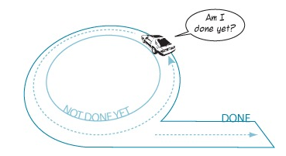
While Loop
Also known as conditional loop.
while (not succeed)
{
keep_trying();
}

Slide 17
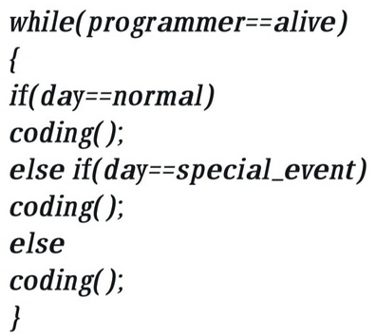
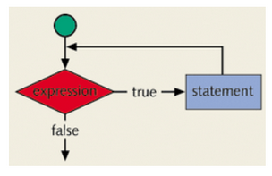
While Loop

Slide 18
#include <stdio.h>
int main()
{
int i=0;
while (i<5)
{
i++;
printf("Hello World\n");
}
return 0;
}
}

Slide 19
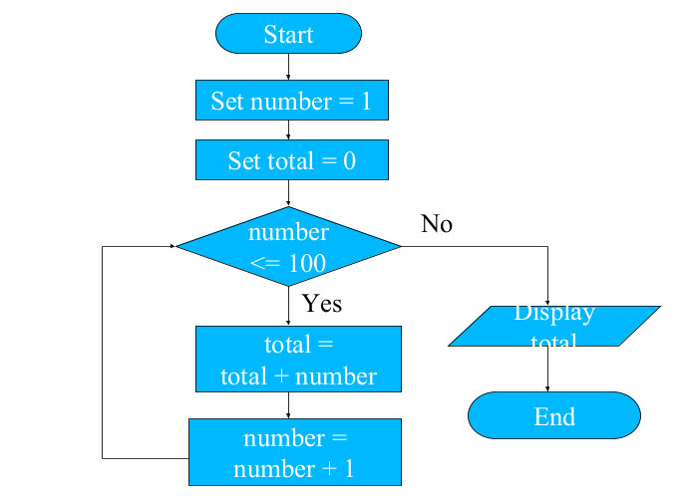
PRactice Question
Make a C program using while loop which calculates the sum of 100 integers 1, 2, 3, …, 100.

Slide 20
#include <stdio.h>
int main()
{
int i=0, sum=0;
while (i<100)
{
i++;
sum=sum+i;
}
printf("The Sum is %d.",sum);
return 0;
}

Slide 21
Practice Question
Make a C program using while loop which calculates the sum of n integers until sum is less than 100.

Slide 22
#include <stdio.h>
int main()
{
int i=0, sum=0;
while (sum<=100)
{
i++;
sum=sum+i;
}
printf("The Sum is %d.",sum);
return 0;
}

Slide 23
Practice Question
Make a C program to convert decimal number to binary.

Slide 24
#include <stdio.h>
int main()
{
int num,a;
printf("Enter decimal number :");
scanf("%d", &num);
while (num!=0)
{
a=num%2;
printf("%d",a);
num=num/2;
}
return 0;
}

Slide 25
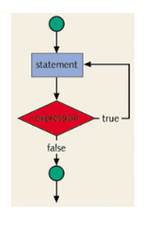
Do- While Loop
do
{
keep_trying();
}
while (not succeed);

Slide 26
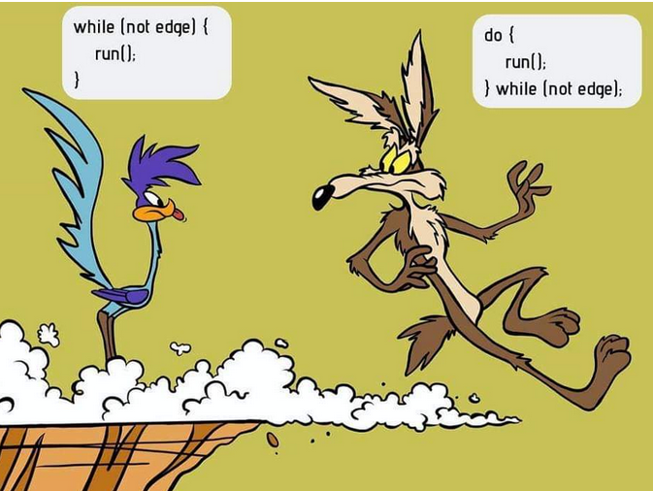

Slide 27

What’s the Output?
i = 11;
while(i <= 10)
{
printf(“%d “,i);
i++;
}
i = 11;
do
{
printf(“%d “,i);
i++;
}
while(i <= 10);

Slide 28
Practice Question
Write a C program using do while to keep asking for a number until you enter a +ve number.

Slide 29
#include <stdio.h>
int main()
{
int num;
do
{
printf("Enter any number :");
scanf("%d", &num);
}
while (num < 0);
return 0;
}

Slide 30
Practice Question
Make a C program which ask the user for the password until it matches with the actual one.
Make a C program which ask the user for the password. If it doesn’t match in 3 trials, it shouldn't ask again.

Slide 31
Home Assignment
Make a C program to print first 50 even numbers.
Make a C program to read an age of 15 person & find out how many of them fall under :
a) Still a baby- age 0 to 5
b) Attending school - age 6 to 17
c) Adult life-age 18 & over

Slide 32
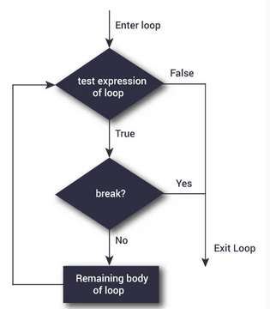
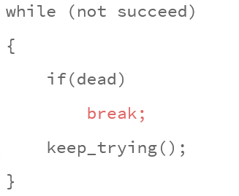
Break
You can use the break statement in while, for, and do...while loops to alter the flow of control.
When the break statement executes in a repetition structure, it immediately exits from these structures.

Slide 33
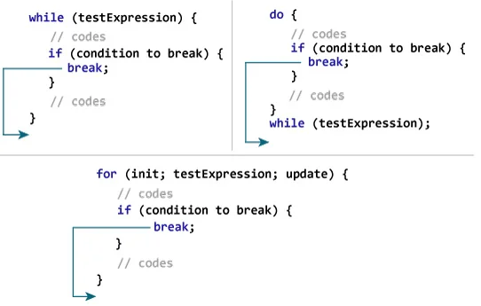
Break

Slide 34
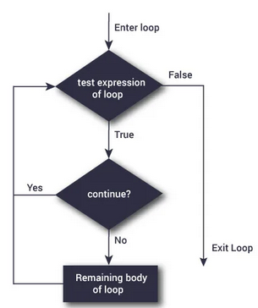
Continue
The continue statement is used in while, for, and do-while structures.
When the continue statement is executed in a loop, it skips the remaining statements and proceeds with the next iteration of the loop.
In a while and do-while structure, the expression (that is, the loop-continue test) is evaluated immediately after the continue statement.
In a for structure, the update statement is executed after the continue statement, and then the loop condition (that is, the loop-continue test) executes.

Slide 35
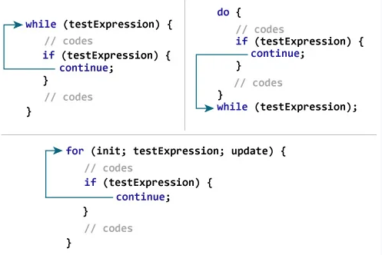
COntinue

Slide 36
Can you print this using for loop?
1
2
3
4
5

Slide 37
Can you print this using for loop?
1
2
3
4
5
for( i=1; i<=5; i++)
{
printf(“%d \n”, i);
}

Slide 38
Can you print this using for loop?
1 2 3 4 5

Slide 39
Can you print this using for loop?
1 2 3 4 5
for( i=1; i<=5; i++)
{
printf(“%d ”, i);
}

Slide 40
Can you print this using for loop?
1 2 3 4 5
1 2 3 4 5

Slide 41
Can you print this using for loop?
1 2 3 4 5
1 2 3 4 5
for( i=1; i<=5; i++)
{ printf(“%d ”, i);}
printf (“\n”);
for( i=1; i<=5; i++)
{ printf(“%d ”, i);}

Slide 42
Can you print this using for loop?
1 2 3 4 5
1 2 3 4 5
1 2 3 4 5
1 2 3 4 5
1 2 3 4 5

Slide 43
Can you print this using for loop?
for( i=1; i<=5; i++)
printf(“%d ”, i);
printf (“\n”);
for( i=1; i<=5; i++)
printf(“%d ”, i);
printf (“\n”);
for( i=1; i<=5; i++)
printf(“%d ”, i);
printf (“\n”);
for( i=1; i<=5; i++)
printf(“%d ”, i);
printf (“\n”);

Slide 44
It’s a for of For Loop
for( j=1; j<=5; j++)
{
for( i=1; i<=5; i++)
printf(“%d ”, i);
printf (“\n”);
}

Slide 45
Can you print this using NESTED for loop?
1
1 2
1 2 3
1 2 3 4
1 2 3 4 5

Slide 46
It’s a for of For Loop
for( j=1; j<=5; j++)
{
for( i=1; i<=j; i++)
printf(“%d ”, i);
printf (“\n”);
}

Slide 47
Can you print this using NESTED for loop?
1 2 3 4 5
1 2 3 4
1 2 3
1 2
1

Slide 48
It’s a for of For Loop
for( j=1; j<=5; j++)
{
for( i=1; i<=6-j; i++)
printf(“%d ”, i);
printf (“\n”);
}

Slide 49
Home Assignment
1
1 2
1 2 3
1 2 3 4
1 2 3 4 5
1 2 3 4
1 2 3
1 2
1

Slide 50
Can you print this using NESTED for loop?
1
1 2
1 2 3
1 2 3 4
1 2 3 4 5

Slide 51
It’s a for of For Loop
for( j=1; j<=5; j++)
{
for( i=1; i<=5-j; i++)
printf(“ ”, i);
for( i=1; i<=j; i++)
printf(“%d”, i);
printf (“\n”);
}

Slide 52
Nested Loops
while(condition) {
printf(“Outer loop”);
while(condition)
{
printf(“Inner Loop”);
}
printf(“Outer loop”);
}

Slide 53
Can you print this using NESTED WHILE loop?
1
1 2
1 2 3
1 2 3 4
1 2 3 4 5

Slide 54
Nested While
int i=1,j;
while(i<6)
{
j=1;
while(j<i)
{
printf("%d",j);
j++;
}
printf("\n");
i++;
}

Slide 55
Can you print this using NESTED WHILE loop?
1
1 2
1 2 3
1 2 3 4
1 2 3 4 5

Slide 56
Nested While
int i=1,j; // Main Loop
while(i<6) // Outer Loop
{
j=1;
while(j<6-i) // Inside loop 1
{
printf(" ");
j++;
}
j=1;
while(j<i) // Inside Loop 2
{
printf("%d ",j);
j++;
}
printf("\n"); // Outer Loop
i++;
}

Slide 57
Can you print this using NESTED WHILE loop?
1
123
12345
1234567
123456789

Slide 58
Nested While
int i=1,j; // Main Loop
while(i<6) // Outer Loop
{
j=1;
while(j<6-i) // Inside loop 1
{
printf(" ");
j++;
}
j=1;
while(j<=2*i-1) // Inside Loop 2
{
printf("%d",j);
j++;
}
printf("\n"); // Outer Loop
i++;
}

Slide 59
Nested Loops
do {
printf(“Outer loop”);
do
{
printf(“Inner Loop”);
} while(condition);
printf(“Outer loop”);
} while(condition);

